Slide 1
GLOBAL SUPPLY CHAIN ANALYTICS
BUSINESS CASE
Team Members:
Faizan Ali Khan Mohammad
Niharika Yarala
Udaya Lakshmi Punnam
Keerthi Pulipaka

Slide 2
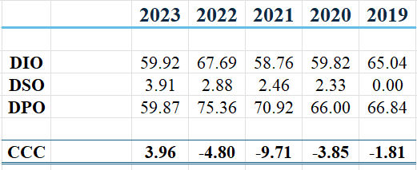
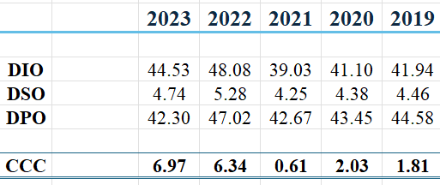
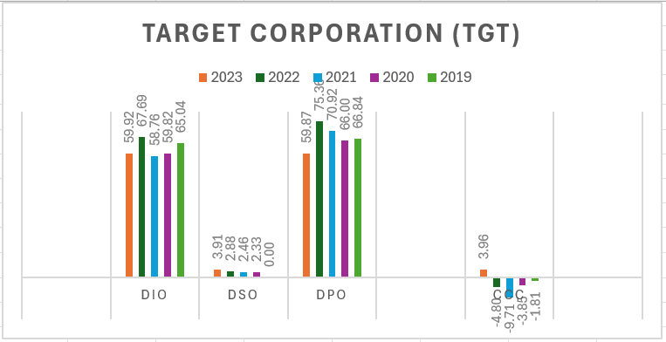
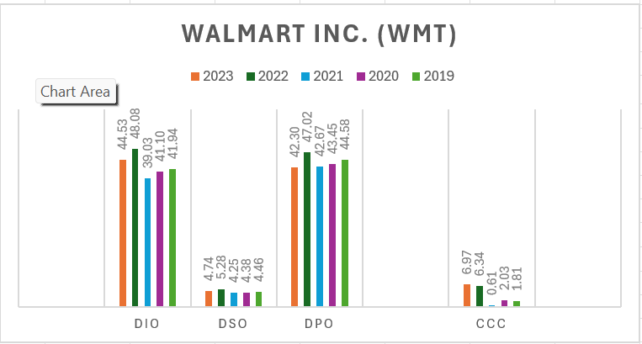
Comparative Analysis Of Target And Walmart (Cash Conversion Cycle)
TARGET CORPORATION (TGT)
WALMART INC. (WMT)

Slide 3
Comparative Analysis Of Target And Walmart (Cash Conversion Cycle)
Days Inventory Outstanding (DIO):
DIO measures the average number of days it takes for inventory to turn into sales.
A lower DIO indicates more efficient inventory management, as inventory is being sold or utilized quickly.
Target's DIO has been consistently higher compared to Walmart over the years, indicating that Target holds inventory for a longer period before it is sold.
Days Sales Outstanding (DSO):
DSO measures the average number of days it takes for a company to collect payment after a sale has been made.
A lower DSO indicates faster collection of receivables and better cash flow management.
Both Target and Walmart have shown relatively low DSO values, indicating efficient collection of receivables. However, Target's DSO has been consistently lower compared to Walmart, suggesting faster collection of payments from customers.
Days Payable Outstanding (DPO):
DPO measures the average number of days it takes for a company to pay its suppliers after receiving goods or services.
A higher DPO indicates that the company is taking longer to pay its suppliers, effectively extending its payment terms.
Target's DPO has been relatively high compared to Walmart, indicating that Target takes longer to pay its suppliers.

Slide 4
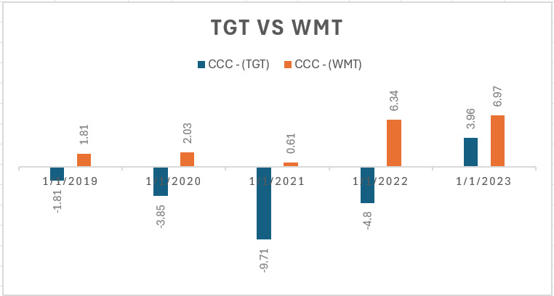
Comparative Analysis Of Target And Walmart (Cash Conversion Cycle)
Cash Conversion Cycle (CCC):
CCC represents the overall efficiency of the company's cash flow management within the supply chain.
A lower CCC suggests that the company is converting inventory into cash more efficiently and managing its working capital effectively.
Target's CCC has been lower compared to Walmart over the years, indicating better cash flow management and efficiency in converting inventory into cash.
Key Observations:
Target generally outperforms Walmart in terms of DSO and CCC, indicating more efficient cash flow management and better inventory turnover.
However, Walmart has a lower DIO and comparable DPO compared to Target, suggesting more efficient inventory management and supplier payment terms.

Slide 5
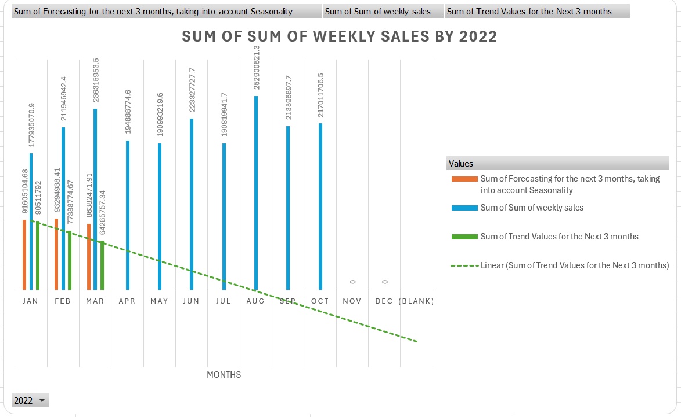
Demand Forecasting Using Linear Forecasting Method
Table shows demand forecast for a product based on historical sales data, trend values, and seasonality.
Linear forecasting method used to predict future values based on past trends and the actual forecasted values are calculated by considering the seasonality of the historical data.
It assumes a steady linear increase in weekly sales. This means it predicts sales to rise at a constant rate in the future.
Sum of forecasted values for next three months used to determine overall demand forecast.

Slide 6
Demand Forecasting Using Linear Forecasting Method
Strengths and Limitations:
Simplicity: This method offers a straightforward approach to forecasting, easily interpretable and computationally efficient.
Limited Scope: As it only considers the historical sales data within a single variable, it may miss external factors impacting demand, such as marketing campaigns, seasonality, or economic changes.
Accuracy: While providing a starting point, the predictions may not be perfectly accurate due to these external influences.

Slide 7
Competitive Advantage of TGT In Entering A Reverse Factoring Program
The potential competitive advantage of Target Corporation (TGT) entering a reverse factoring program (SCF financing) using numbers:
Cost of Debt Savings:
Average cost of debt: 3.84%
If Target can secure SCF financing at a lower rate, say 3%, it would save 0.84% on financing costs.
If Target has $10 billion in supplier invoices annually, the potential annual savings would be $84 million (10,000,000,000 * 0.0084).
Working Capital Optimization:
Extending payment terms by, for example, 30 days can effectively free up working capital.
If Target's annual cost of goods sold (COGS) is $70 billion and it extends payment terms by 30 days, it can potentially free up $5.75 billion in working capital (70,000,000,000 / 365 * 30).

Slide 8
Competitive Advantage of TGT In Entering A Reverse Factoring Program
Discount Negotiation:
Suppose Target negotiates a 2% discount with suppliers for participating in the SCF program.
If Target's annual purchases from suppliers amount to $50 billion, it could save $1 billion annually (50,000,000,000 * 0.02).
Supply Chain Resilience:
Avoiding supply chain disruptions due to financial distress can prevent revenue loss.
If a disruption leads to a 5% reduction in revenue, which is $75 billion for Target, ensuring supply chain resilience could potentially save $3.75 billion annually (75,000,000,000 * 0.05).

Slide 9
Competitive Advantage of TGT In Entering A Reverse Factoring Program
Enhanced Supplier Relationships:
Strengthening supplier relationships could lead to various benefits such as preferential pricing or access to new products.
If, due to improved relationships, Target secures a 1% reduction in purchase costs, it could save $500 million annually (50,000,000,000 * 0.01).

Slide 10
Conclusion
Target may need to further analyze its inventory management and supplier payment processes to identify opportunities for improvement.
Understanding the factors contributing to Walmart's lower DIO and comparable DPO can help Target implement strategies to enhance its supply chain efficiency and competitiveness.
The linear forecasting method offers an initial glimpse into future demand. While providing a basic estimate, it's crucial to remember the limitations and consider broader external factors for more comprehensive forecasting.
By implementing a reverse factoring program, Target can potentially realize substantial financial benefits, including cost savings on financing, working capital optimization, discounts from suppliers, revenue protection from supply chain disruptions, and improved purchasing terms through enhanced supplier relationships. These numerical examples highlight the significant competitive advantage that SCF financing can offer to Target Corporation.

Slide 11
THANK YOU

